Slide 2
Optimization of UrbanServices Using Priority Queue
Submitted to:
Department of Information Technology

Slide 3
Supervised by: Prof.Prashant Lakkadwala
Team Members
1.Jahnavi Mandloi
2.Jayshree Dave
3.Mahee Dubey
4.Minakshi Soni

Slide 4
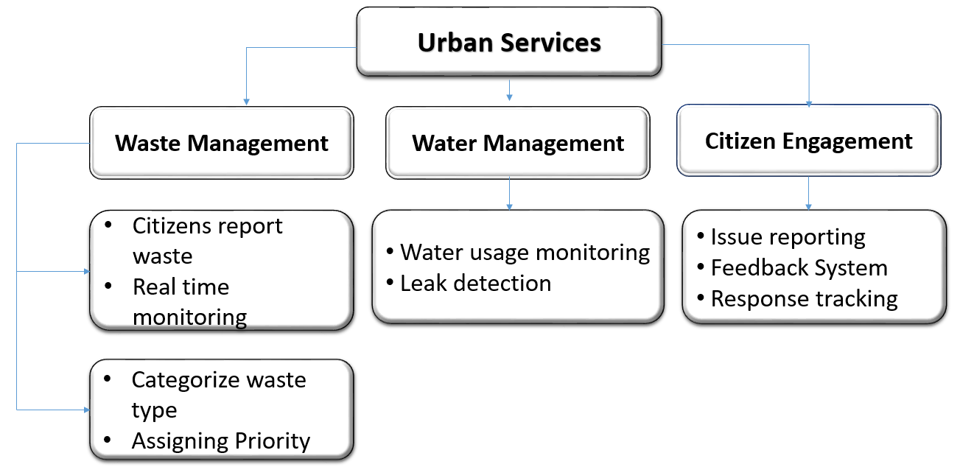
Block Diagram
Figure 1: Description of job seeker hub users

Slide 5
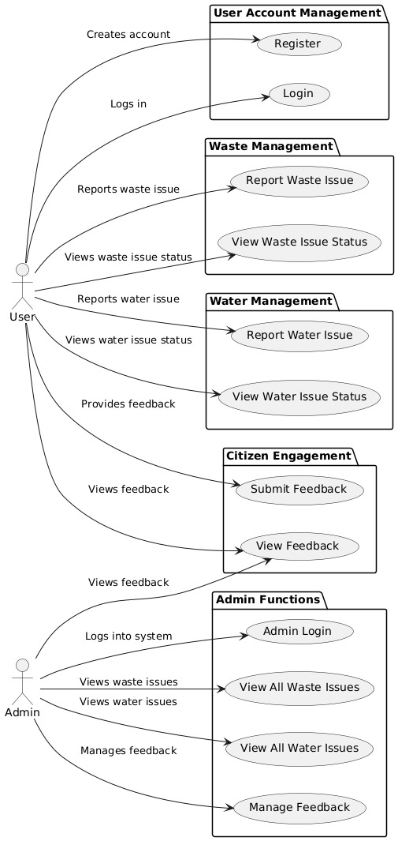
Use Case Diagram

Slide 6
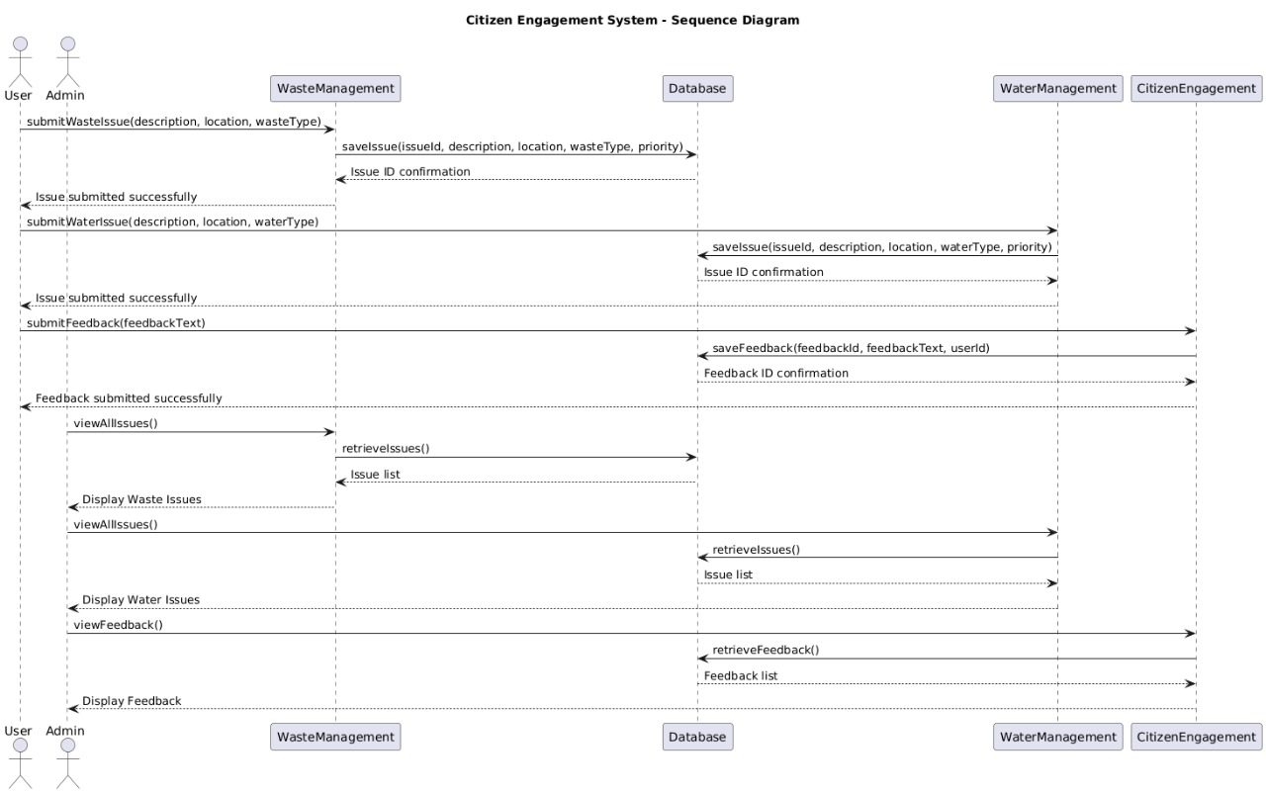
Sequence Diagram

Slide 7
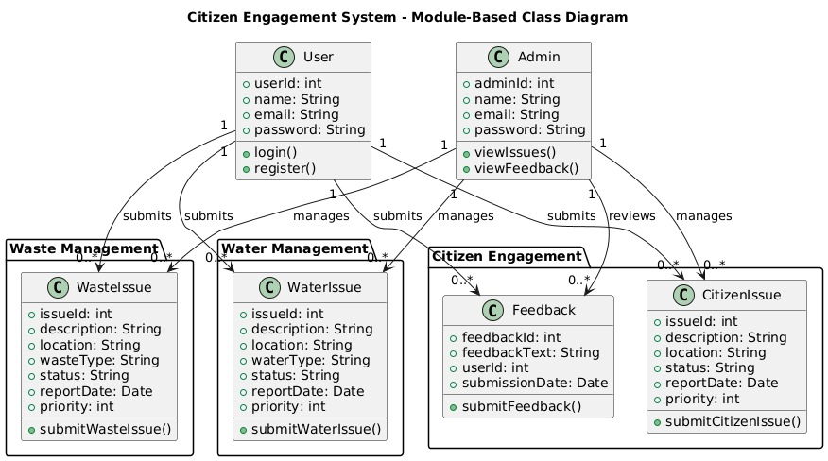
Class Diagram

Slide 8
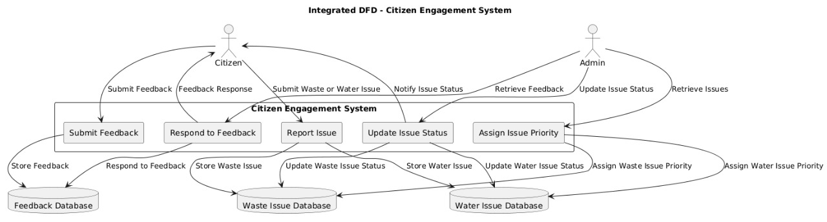
Data Flow Diagram

Slide 9
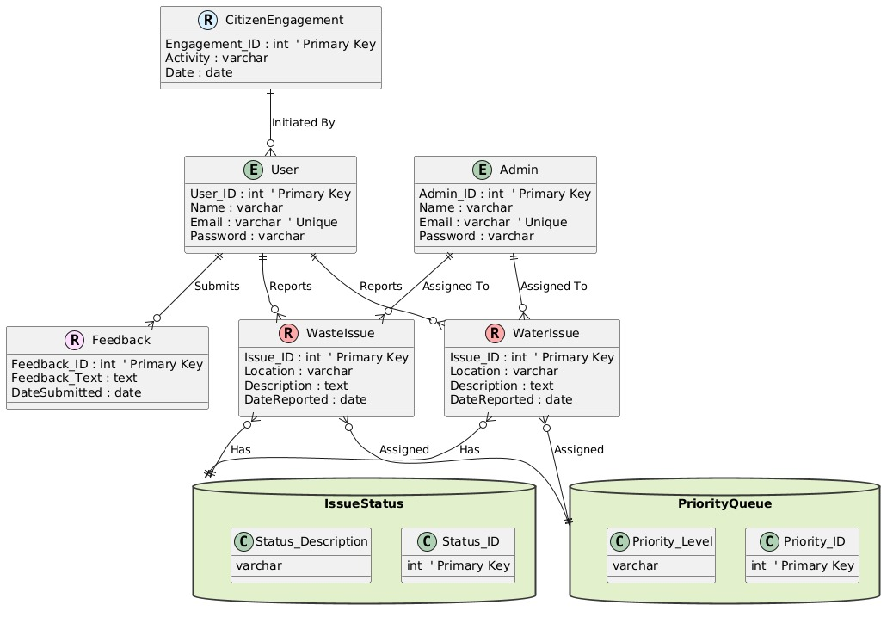
ER Diagram

Slide 10
Q&A

Slide 11
THANKS

